Slide 1

Data Structures and Algorithms
Presented by:
Elizer Ponio Jr.

Slide 2

Are you a neat freak?
Notes:
Let me tell you a story
During the covid 19 pandemic.
too small, too big, too cluttered rooms

Slide 3
Why do people organize?
To feel a semblance of control
To know where things are without searching
People find comfort in predictability.
Notes:
Have you asked yourself the question, why do people organize?
Lets go to the psychology of organizing
This predictability applies within the context of our homes, manifesting through the concept of organization

Slide 4
What is a Data Structure?
A storage that is used to store and organize data.
It is a way of arranging data on a computer so that it can be accessed and updated efficiently.

Slide 5
Types of Data Structures
Linear data structure
Non-linear data structure

Slide 6
Linear Data Structures
Data are arranged in sequence or in a particular order.

Slide 7
Arrays
A variable that can store multiple values/elements of the same type.
Each element can be accessed by their index number.
Notes:
Values technically are called array elements.

Slide 8
Arrays
Jollibee | McDonalds | KFC | Chowking | Mang Inasal
0 | 1 | 2 | 3 | 4
Notes:
Values technically are called array elements.

Slide 9
Python collection (Arrays)
List:
list1 = ['physics', 'chemistry', 1997, 2000] list2 = [1, 2, 3, 4, 5 ] list3 = ["a", "b", "c", "d"]
Tuple:
tuple1 = ('physics', 'chemistry', 1997, 2000);
tuple2 = (1, 2, 3, 4, 5 );
tuple3 = "a", "b", "c", "d";
Set:
Days = set(["Mon","Tue","Wed","Thu","Fri","Sat","Sun"])
Notes:
List items are ordered, changeable, and allow duplicate values.
Tuple items are ordered, unchangeable, and allow duplicate values.
Set items are unordered, unchangeable, and do not allow duplicate values.

Slide 10
Stack
Elements are arranged in a pile/stack.
The first element will be at the bottom.
The last element will be at the top.
Follows the LIFO (Last in First Out) principle

Slide 11

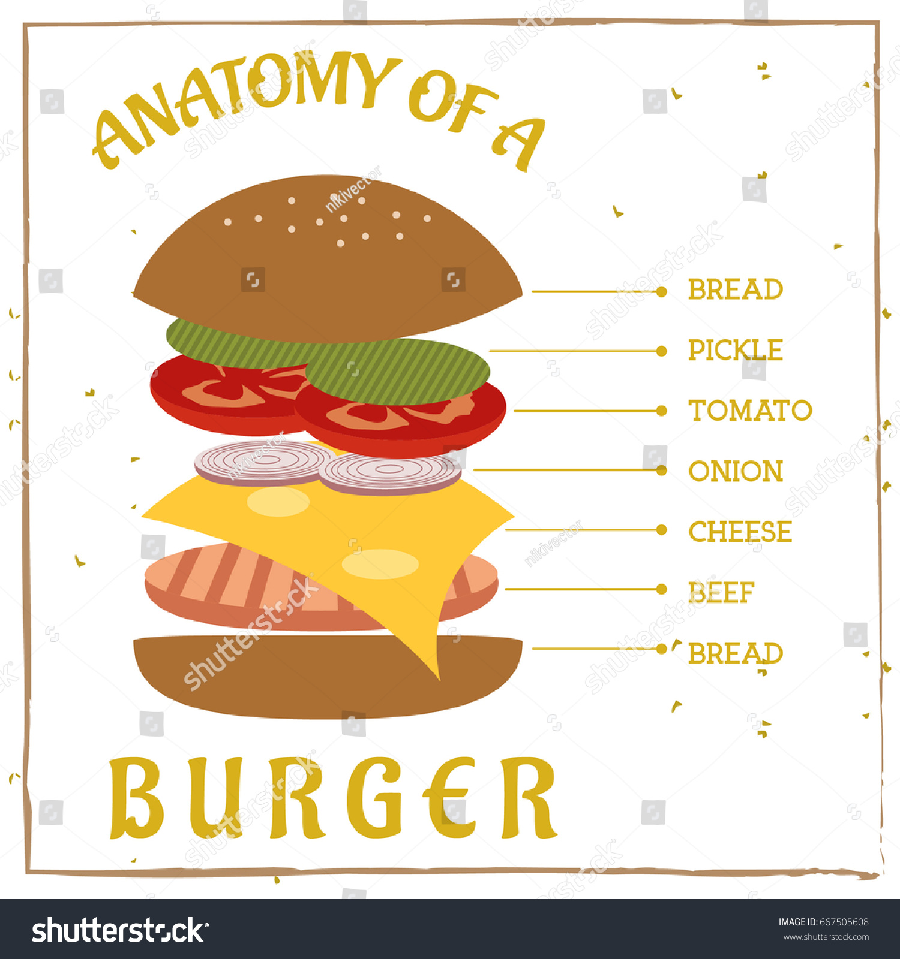
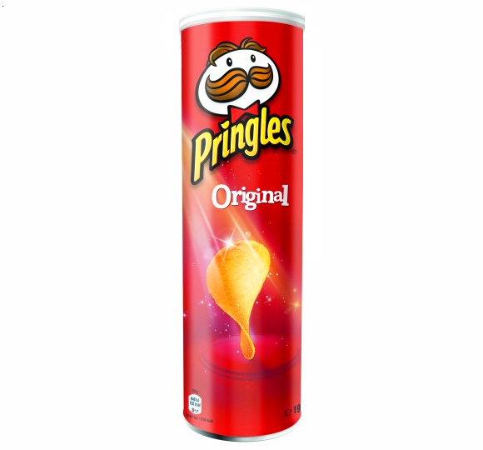
Stack
Top Bun
Lettuce
Tomato
Onion
Cheese
Beef Patty
Bottom Bun

Slide 12
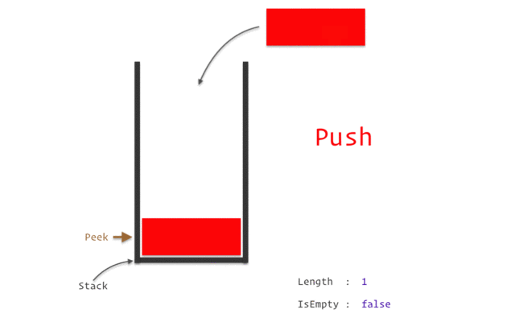
LIFO principle
Notes:
In a stack,
Removing an element is called pop.
Inserting an element is called push.

Slide 13
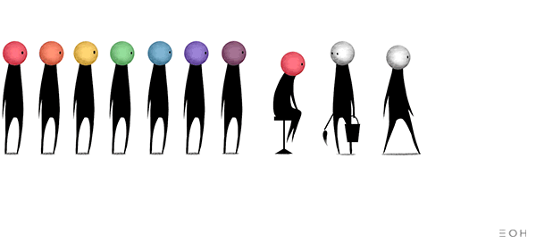
Queue
Elements are arranged in a queue.
The first element will be at the front.
The last element will be at the rear.
Follows the FIFO (First in First out) principle.
Notes:
When you go to a packed restaurant on a holiday. You sign on a waiting list.

Slide 14
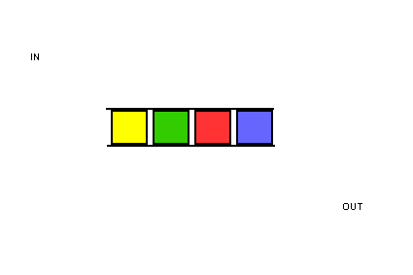
FIFO principle
Notes:
In a queue,
Inserting an element is called enqueue.
Removing an element is called dequeue.

Slide 15
Linked List
Is a sequence of linked/connected elements is known as a node.
Each node contains a connection to another node in form of a pointer.

Slide 16
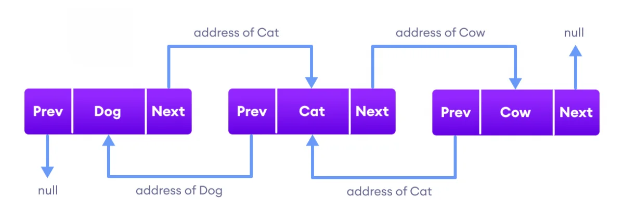
Linked List
Notes:
The previous pointer contains the address of the preceding node
The next pointer contains the address of the succeeding node.

Slide 17
Non-linear Data Structures
Unlike linear data structures, data in non-linear data structures are not in any order.

Slide 18
Hash table
Stores elements in key-value pairs where,
Key
Unique string/integer that is used for indexing/retrieving values.
Value
Data that are associated with keys.
Notes:
Have you asked yourself the question, why do people organize?
Lets go to the psychology of organizing
This predictability applies within the context of our homes, manifesting through the concept of organization

Slide 19
Key – Value Pairs
Song Title (Key) | Song Code (Value)
High hopes | 0000
This Love | 1111
God’s Plan | 2222
Sugar | 3333
Notes:
Have you asked yourself the question, why do people organize?
Lets go to the psychology of organizing
This predictability applies within the context of our homes, manifesting through the concept of organization

Slide 20

Hash table
High Hopes
0
Hash function
0 | 1 | 2 | 3
0000
Notes:
Have you asked yourself the question, why do people organize?
Lets go to the psychology of organizing
This predictability applies within the context of our homes, manifesting through the concept of organization

Slide 21
Hash table
This Love
1
Hash function
0 | 1 | 2 | 3
0000
1111
Notes:
Have you asked yourself the question, why do people organize?
Lets go to the psychology of organizing
This predictability applies within the context of our homes, manifesting through the concept of organization

Slide 22
Hash table
God’s Plan
3
Hash function
2222
0 | 1 | 2 | 3
0000
1111
Notes:
Have you asked yourself the question, why do people organize?
Lets go to the psychology of organizing
This predictability applies within the context of our homes, manifesting through the concept of organization

Slide 23
Hash table
Sugar
2
Hash function
0 | 1 | 2 | 3
0000
1111
3333
2222
Notes:
Have you asked yourself the question, why do people organize?
Lets go to the psychology of organizing
This predictability applies within the context of our homes, manifesting through the concept of organization

Slide 24
Python Dictionaries (Hash table)
thisdict = { “High Hopes": “0000", “This Love": “1111", “God’s Plan": 3333
“Sugar”: 2222 }
Notes:
Dictionary items are ordered, changeable, and does not allow duplicates.

Slide 25
Tree
A tree is a non-linear hierarchical data structure that consists of nodes connected by edges.

Slide 26
Node and Edge
Node
A
Edge
Edge
Node
B
C
Node
Edge
Edge
Edge
Edge
Node
D
E
Node
F
Node
G
Edge
Edge
Node
H
I
Node
Notes:
Nodes:
The elements that makes up the tree
Edges
The connection between two nodes.

Slide 27
Root, Parent, Child, Leaf
Root
A
Level 0
Parent Node
B
C
Level 1
Child Node
D
E
Leaf Node
F
Siblings
G
Level 2
H
I
Level 3
Notes:
Root
node at the top of the tree
Parent
A node except the root node that has one edge down to another node.
Child
A node that has one edge up to another node.
Siblings
Two or more nodes that have the same parent node.
Leaf
A node without any child nodes.

Slide 28
Height and Depth
Height = 3
Depth = 0
A
Height = 2
Depth = 1
B
C
Height = 0
Depth = 1
Height = 1 Depth = 2
D
E
Height = 0 Depth = 2
F
Height = 0
Depth = 2
G
Height = 0
Depth = 2
Height = 0
Depth = 3
H
I
Height = 0
Depth = 3
Notes:
Height of a node
- The number of edges from the node to the deepest leaf
Count starts at zero
Depth of a node
- The number of edges from the root to the node.
- Count starts at zero

Slide 29
Degree of a node
A
Degree of node A = 2
B
C
D
E
F
G
H
I
Notes:
Degree of a node
- The number of its children

Slide 30
Degree of a node
A
Degree of node B = 2
B
C
D
E
F
G
H
I

Slide 31
Degree of a node
A
B
C
Degree of node D = 2
D
E
F
G
H
I

Slide 32
Degree of a node
A
B
C
Degree of node C = 2
D
E
F
G
H
I

Slide 33
Degree of a node
A
B
C
D
E
F
G
H
I
Degree of nodes H, I ,E F, G = 0

Slide 34
Graph
A graph data structure consists of:
A collection of vertices.
A collection of edges, represented as ordered pairs of vertices.

Slide 35
Terminologies
Vertices
Vertex
Edge
Adjacency
Path

Slide 36




What is a Graph?
Jane
Ronn
Vertices:
Jane, Nica, Jonnah, Ronn
Edges:
Jane - Nica
Jane - Jonnah
Jane - Ronn
Nica - Jonnah
Jonnah
Nica

Slide 37
Adjacency
A vertex is said to be adjacent to another vertex if there is an edge connecting them.

Slide 38
Adjacency
Jane
Ronn
Jane is adjacent to Nica, Jonnah and Ronn.
Ronn is not adjacent to Jonnah.
Jonnah
Nica

Slide 39
Path
A sequence of edges that allows you to go from vertex A to vertex B is called a path.

Slide 40
Path
Jane
Ronn
Path from Nica to Ronn:
1. Nica to Jane.
2. Jane to Ronn.
Jonnah
Nica

Slide 41
Types of Graphs

Slide 42

Directed Graph
A graph in which an edge has a direction.
Tristan
Jane

Slide 43

Undirected Graph
A graph in which an edge does not have any direction.
Nica
J-Rhyzz

Slide 44
Connected Graph
A graph where every node can be visited from other nodes.
Jane
Tristan
J-Rhyzz
Nica

Slide 45
Disconnected Graph
A graph in which at least one node is not reachable from a node.
Jane
Tristan
J-Rhyzz
Nica

Slide 46
Complete Graph
A graph in which each node has edges to all other nodes
Jane
Tristan
J-Rhyzz
Nica

Slide 47
Weighted Graph
A weighted graph is a special type of graph in which edges are assigned some weights which represent cost, distance.
1
2
Jane
Tristan
J-Rhyzz
3
4
Nica

